Slide 1

SRM INSTITUTE OF SCIENCE AND TECHNOLOGY Ramapuram Campus , Chennai – 600 089 DEPARTMENT OF COMPUTER SCIENCE AND ENGINEERING
18CSP107L-MINOR PROJECT
GUI BASED EXPENSE TRACKER USING TKINTER LIBRARIES AND SQLITE
BATCH NUMBER :14
Team Members | Supervisor
P.V.MOHAN KAMAL(RA2011027020045) E.G.SIDDARTH VARMA(RA2011027020018) CH.SIVA PRASAD(RA20110270200120) | NAME: Ms.S.Aarthi Assistant professor, department of computer Science and Engineering

Slide 2
AGENDA
Abstract
Scope and Motivation
Introduction
Literature Survey ( Table)
Objective
Problem Statement
Proposed Work
Architecture Diagram/Flow Diagram/Block Diagram
Novel idea
Modules
Module Description
Software & Hardware Requirements
Results and Discussion
Conclusion
Future Work
References (Base paper hard copy to be submitted to the supervisor.)
Way forward towards Outcome (Research Paper/Patent)

Slide 3
ABSTRACT
This expense tracker minor project is a software application developed to assist users in managing their expenses effectively.
The project incorporates a Graphical User Interface (GUI) to enhance user interaction and ease of use. Through the GUI, users can input and categorize their income and expenses, creating a clear financial record
The expense tracker’s GUI allows users to set budgets, view expense trends, and generate insightful reports and charts for better financial analysis.
The user-friendly interface enables effortless data entry and provides a visually appealing representation of financial data.

Slide 4
SCOPE AND MOTIVATION
This project aims to develop a user-friendly software application that simplifies expense management. It will feature an intuitive Graphical User Interface (GUI) for easy interaction, allowing users to input, categorize, and track their income and expenses effortlessly The project’s scope includes incorporating budget-setting capabilities, generating graphical reports and charts for expense trends analysis, and ensuring data security. The motivation behind the project lies in empowering users to take control of their finances, promoting better financial planning, and offering a practical tool for both personal and business expense tracking.

Slide 5
INTRODUCTION
This project introduces an efficient solution for individuals to manage their financial records. This endeavor aims to simplify the process of expense tracking through a graphical user interface (GUI) application. By enabling users to effortlessly log, categorize, and comprehend their expenditures
In simpler way It's like a digital piggy bank, making it easier to see and manage your spending habits. We're building a user-friendly computer program that lets you input your spending details easily. this project aims to enhance financial awareness and provide valuable insights into spending This project aims to make managing your finances straightforward and stress-free habits.

Slide 6
LITERATURE SURVEY
s.no | Title of the Paper | Year | Journal/Conference Name | Inferences
1. | Personal automated expense tracker | 2023 | International journal of research vol 4,no 3 | Expensify: A Expensify is a mobile appbased spending tracker and report maker, and this essay assesses its efficacy Personal Finance Management: - An app called Cashew for tracking mobile expenses is designed and evaluated in this study
2. | Group Expense tracking application | 2022 | IRJMETS Vol4/issue 4 | The popular expense-tracking applications Mint, Pocket Guard, and Personal Capital are reviewed in this paper
3. | expense tracking and managing application | 2022 | IJARIIE-Vol8/issue 2 | The application makes a record of the Income and Expenses of the user on daily basis. If you exceed daily expense allowed amount it will give you a warning

Slide 7
s.no | Title of paper | year | Journal/conference name | inference
4. | Expenditure management system | 2022 | Journal of engineering, | Proposed an expense tracker to prevent having to calculate income and expenses user have categories as add expense,monthly expenses
5 | Budget tracker | 2020 | IJARSCT vol 9,issue 4 | Users to maintain Digital automated diary.each user will be required to register on the system
6. | Income and expense tracker | 2023 | International journal Of science and technology | Adding some feauters add income,addcateogries export income,Remove export files
SNO
Title of the Paper
Year
Journal/Conference Name

Slide 8
sno | Title of paper | year | Journal conference name | Inference
7. | Compatible multidevice expense tracking application | 2020 | ICCPET | In this paper, we develop a mobile application developed for the android platform that keeps record of user personal expenses, top investment options, view of the current stock market
8. | Document based smart expense tracker | 2022 | IJRESM VOL 5,issue 5 | Helps in accordance with maintain the document regarding daily costs yet month-to-month income because someone person or additionally generates a month-tomonth file over the expenses
9. | Development of application for expense accounting | 2021 | 2021 IEEE Conference | Accounting of personal finances will help to save money and make only necessary purchases, will help to analyze your expenses, correctly plan your budget and rationally use money
10. | University student survival kit | 2020 | 2020 IEEE conference | The purpose of this paper is to develop a multilfunction mobile application for private university students . The app includes notes reminder calendar

Slide 9
OBJECTIVE
The objective of the expense tracker minor project is to develop a user-friendly software application that enables efficient expense management.
Through an intuitive Graphical User Interface (GUI), users can easily input, categorize, and track their income and expenses.
The project aims to promote better financial planning by allowing users to set budgets, visualize expense trends with reports and charts, and make informed decisions about their finances.

Slide 10
PROBLEM STATEMENT
In today's fast-paced world, managing personal finances can become a challenge. Many individuals struggle to keep track of their spending habits, leading to financial stress and mismanagement. Traditional methods of expense tracking, such as pen-and-paper or spreadsheets, often lack convenience and fail to provide insightful visualizations of spending patterns.

Slide 11
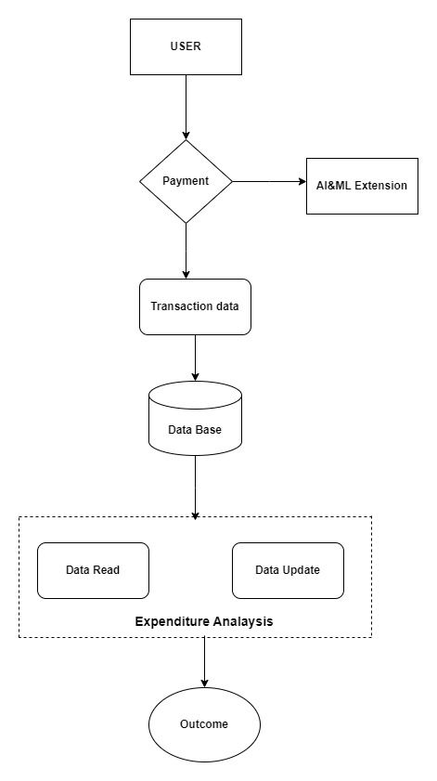
PROPOSED WORK
Architecture diagram:
fig1:architecture diagram

Slide 12
NOVEL IDEA
Detailed spent analysis : Allowing users to know detailed analysis using pictural representation for clear understanding like bar graphs, pie charts
Displaying in categories: showing all the expenses in different categories respectively so users can know the where they are spending more money and can save money .
Mode of payment category: Allowing users to know which mode of payment they are using and using those transactions they can add expenses easily to database
Simplifying process: There is no use of manual calculations to know how much they spent it will consume lot of time and may lead to errors using GUI tracker can understand by pie charts and bar graphs
Giving alerts: when users spending too much money than prescribed amount user will alert to reduce spending in coming days .if we spend amount less than the target reward will be granted

Slide 13
MODULES
Modules:
a.Login module
b.Add bill
c.Delete the bill
d.View expense
e.Categories module

Slide 14
MODULE DESCRIPTION
Modules description: The mission can stay decomposed within the consonant modules:
a) Login module: This module is responsible because a registered person by login yet does the proceedings.
b) Add bill: This module is responsible after enable the person to gather a later bill.
c) Delete the bill: This module is responsible for the predefined bill.
d) View expense: This module is responsible because of viewing all the fees of detail introduced in conformity with the bole through the logged user.
e)Categories module: This module is accountable because of a range of options. In this application, users have preferences in deciding on various fundamental price categories.

Slide 15
SOFTWARE & HARDWARE REQUIREMENTS
Software Requirements:
Operating System: The application can run on Windows, macOS, or Linux operating systems.
Programming Language: Depending on your choice of development, you'll need either Python or Java.
3.GUI Framework/Library:
Python: Tkinter for Python GUI development or PyQt for more advanced features.
Java: JavaFX for building the graphical interface.
Hardware Requirements:
Processor: A modern processor (e.g., Intel Core i3 or equivalent) capable of running the chosen programming language and IDE.
Memory (RAM): At least 4GB of RAM is recommended for smooth application development.
Storage: A few GB of free storage space for development tools, libraries, and project files.
Display: A monitor with a resolution of 1280x800 or higher for comfortable programming and GUI design.

Slide 16
IMPLEMENTATION
import datetime
import sqlite3from tkcalendar
import DateEntryfrom tkinter
import *import tkinter.messagebox as mbimport tkinter.ttk as ttk
# Connecting to the Database
connector = sqlite3.connect("Expense Tracker.db")cursor = connector.cursor()connector.execute( 'CREATE TABLE IF NOT EXISTS ExpenseTracker (ID INTEGER PRIMARY KEY AUTOINCREMENT NOT NULL, Date DATETIME, Payee TEXT, Description TEXT, Amount FLOAT, ModeOfPayment TEXT)')connector.commit()
# Functions
def list_all_expenses(): global connector, table table.delete(*table.get_children()) all_data = connector.execute('SELECT * FROM ExpenseTracker')

Slide 17
IMPLEMENTATION
surety = mb.askyesno('Are you sure?', f'Are you sure that you want to delete the record of {values_selected[2]}') if surety: connector.execute('DELETE FROM ExpenseTracker WHERE ID=%d' % values_selected[0]) connector.commit() list_all_expenses() mb.showinfo('Record deleted successfully!', 'The record you wanted to delete has been deleted successfully’)
def remove_all_expenses(): surety = mb.askyesno('Are you sure?', 'Are you sure that you want to delete all the expense items from the database?', icon='warning') if surety: table.delete(*table.get_children()) connector.execute('DELETE FROM ExpenseTracker') connector.commit() clear_fields() list_all_expenses() mb.showinfo('All Expenses deleted', 'All the expenses were successfully deleted')

Slide 18
IMPLEMENTATION
else: mb.showinfo('Ok then', 'The task was aborted and no expense was deleted!')def add_another_expense():global date, payee, desc, amnt, MoP global connector if not date.get() or not payee.get() or not desc.get() or not amnt.get() or not MoP.get(): mb.showerror('Fields empty!', "Please fill all the missing fields before pressing the add button!") else: connector.execute( 'INSERT INTO ExpenseTracker (Date, Payee, Description, Amount, ModeOfPayment) VALUES (?, ?, ?, ?, ?)', (date.get_date(), payee.get(), desc.get(), amnt.get(), MoP.get()) ) connector.commit() clear_fields() list_all_expenses() mb.showinfo('Expense added', 'The expense whose details you just entered has been added to the database')

Slide 19
IMPLEMENTATION
def edit_expense():global table
def edit_existing_expense():
global date, amnt, desc, payee, MoP global connector,
table.current_selected_expense = table.item(table.focus()) contents = current_selected_expense['values']connector.execute('UPDATE ExpenseTracker SET Date = ?, Payee = ?, Description = ?, Amount = ?, ModeOfPayment = ? WHERE ID = ?' (date.get_date(), payee.get(), desc.get(), amnt.get(), MoP.get(), contents[0])) connector.commit()
clear_fields()
list_all_expenses()
mb.showinfo('Data edited', 'We have updated the data and stored in the database as you wanted')

Slide 20
IMPLEMENTATION
# Treeview
Frametable = ttk.Treeview(tree_frame, selectmode=BROWSE, columns=('ID', 'Date', 'Payee', 'Description', 'Amount', 'Mode of Payment’))
X_Scroller = Scrollbar(table, orient=HORIZONTAL, command=table.xview)
Y_Scroller = Scrollbar(table, orient=VERTICAL, command=table.yview)
X_Scroller.pack(side=BOTTOM, fill=X)
Y_Scroller.pack(side=RIGHT, fill=Y)table.config(yscrollcommand=Y_Scroller.set, xscrollcommand=X_Scroller.set)
table.heading('ID', text='S No.', anchor=CENTER)
table.heading('Date', text='Date', anchor=CENTER)
table.heading('Payee', text='Payee', anchor=CENTER)
table.heading('Description', text='Description', anchor=CENTER)
table.heading('Amount', text='Amount', anchor=CENTER)
table.heading('Mode of Payment', text='Mode of Payment', anchor=CENTER)

Slide 21
IMPLEMENTATION
table.column('#0', width=0, stretch=NO)
table.column('#1', width=50, stretch=NO)
table.column('#2', width=95, stretch=NO) # Date columntable.column('#3', width=150, stretch=NO) columntable.column('#4', width=325, stretch=NO)
columntable.column('#5', width=135, stretch=NO)
columntable.column('#6', width=125, stretch=NO)
columntable.place(relx=0, y=0, relheight=1, relwidth=1)list_all_expenses()
windowroot.update()
root.mainloop()

Slide 22
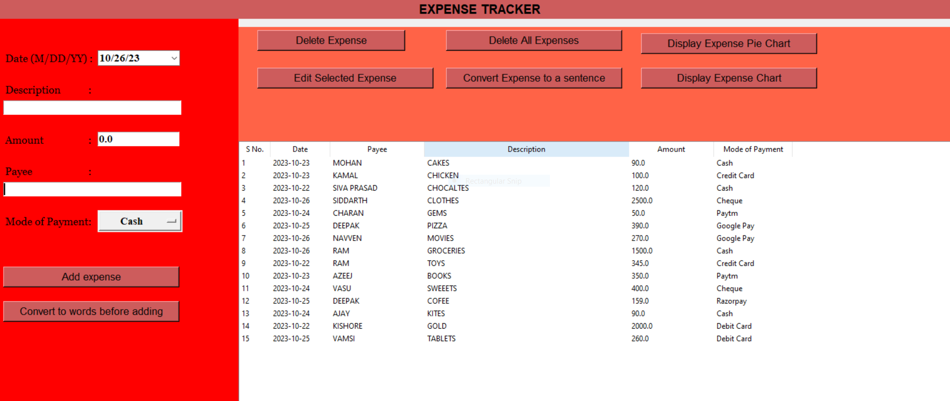
Results and Discussion
Screenshots of Output
fig3:tabulated results of expenses added

Slide 23
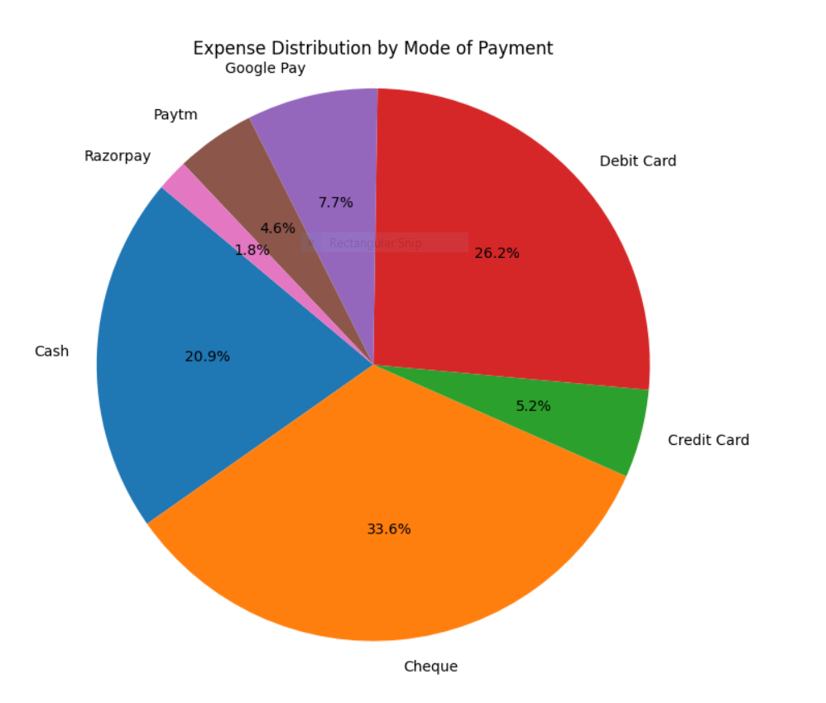
fig4:spent analysis using pie chart

Slide 24
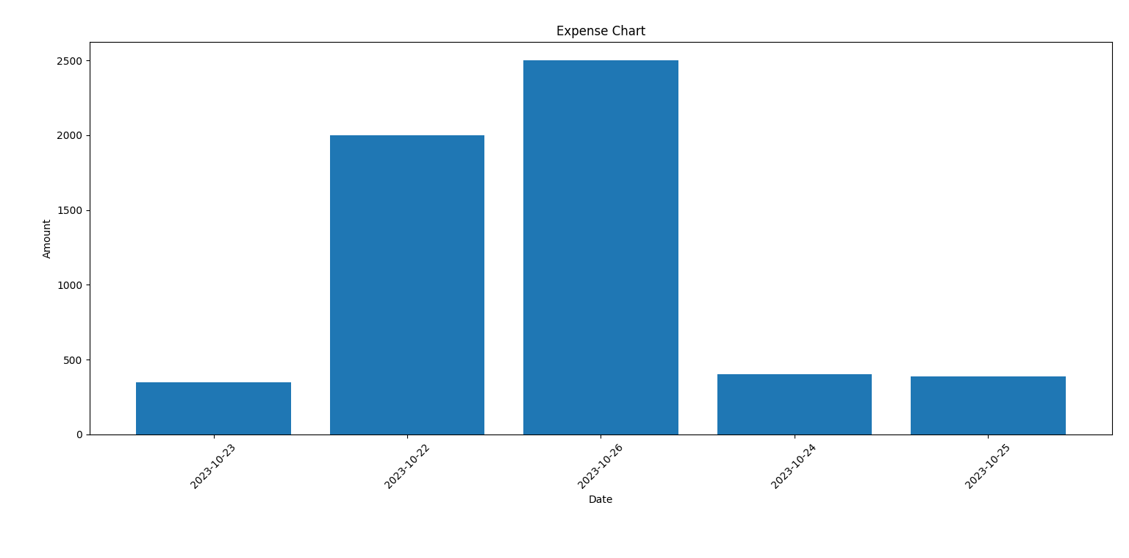
fig5:spent analysis using bar graph

Slide 25
Conclusion
In conclusion, the GUI-Based Expense Tracker project represents a significant step forward in the realm of personal finance management. This project addresses the common challenges people face when it comes to tracking their expenses and managing their finances effectively.
By incorporating a user-friendly Graphical User Interface (GUI), users are provided with an intuitive platform to input, categorize, and analyze their income and expenses, eliminating the need for cumbersome manual record-keeping methods. With the potential for future enhancements, this application holds promise in helping users manage their finances with ease and confidence

Slide 26
Future Work
The future work for a GUI-based expense tracker project can involve various enhancements, improvements, and new features to make the application more useful and user-friendly. Here are some ideas for future work on such a project:
Cloud Integration: Implement cloud storage and synchronization (e.g., using services like Dropbox or Google Drive) to ensure that users can access their expense data from any device
Data Analytics: Add data analysis features to provide users with insights into their spending habits. Visualize spending trends, categorize expenses, and offer suggestions for cost-saving.
Localization: Provide multi-language support and adapt the app to different regions and their unique tax and financial regulations.
Gamification: Add gamification elements to encourage users to be more financially responsible. Rewards and badges for achieving financial goals can be motivating.

Slide 27
REFERENCES
[1] Donn Felker, “Android Application Development for Dummies”, published by For Dummies, 2020
[2]Ed Burnette, “Hello, Android: Introducing Google’s Mobile Development Platform”, published by Pragmatic Bookshelf, 2021.
[3]Lee, “Beginning Android Application Development”, Published by WroxPress, 2022
[4]Reto Meier, “Professional Android™ 2 Application Development”, published by Wiley publishing, 2020.
[5]Zigurd Mednieks (Goodreads Author), Laird Dornin, G. Blake Meike, Masumi Nakamura,Programming Android, published by O’Reilly
Media,2021.
[6]. Accreditation and Quality Assurance Committee (AQAC) in Palestine. General Report of InformationTechnology and Engineering Higher Education in Palestine. Accreditation and Quality Assurance 2022 [7]. Engineering Association of Palestine. Current Engineering Statistics Book. Ramallah; 2022
[8]. Chen JW, Yen M. Engineering Accreditation: A Foundation for Continuing Quality Improvement. 2020

Slide 28
REFERENCES
[9] C K Gomathy and V Geetha. Article: A Real Time Analysis of Service based using Mobile Phone Controlled Vehicle using DTMF for Accident Prevention. International Journal of Computer Applications 138(2):11-13, March 2022.
[10] C K Gomathy and V Geetha. Article: Evaluation on Ethernet based Passive Optical Network Service Enhancement through Splitting of Architecture. International Journal of Computer Applications 138(2):14-17, March 2021.
[11] Dr.C K Gomathy, Article: A Study on the recent Advancements in Online Surveying , International Journal of Emerging technologies ,2022

Slide 29
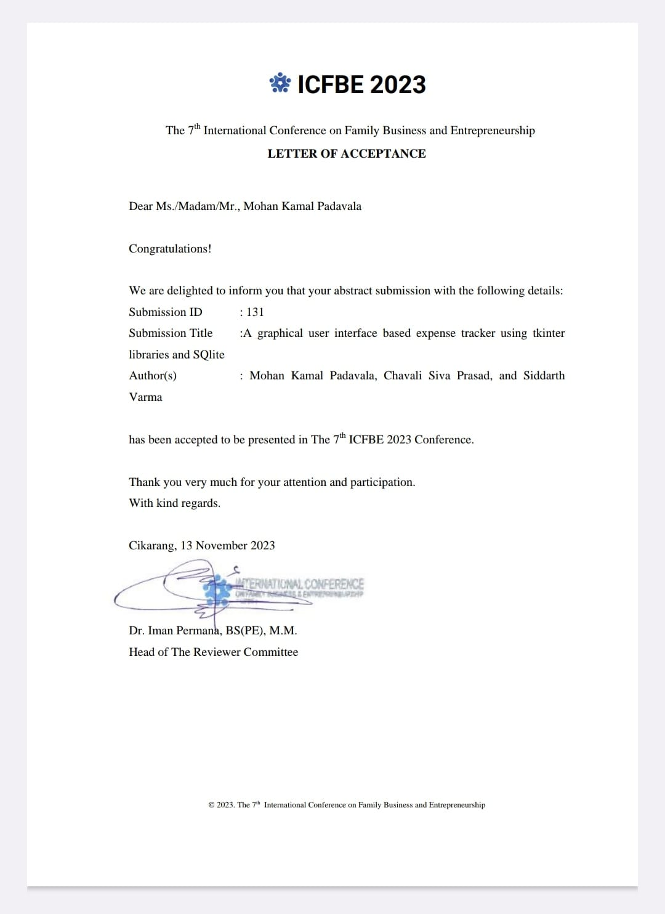
OUT COME

Slide 30
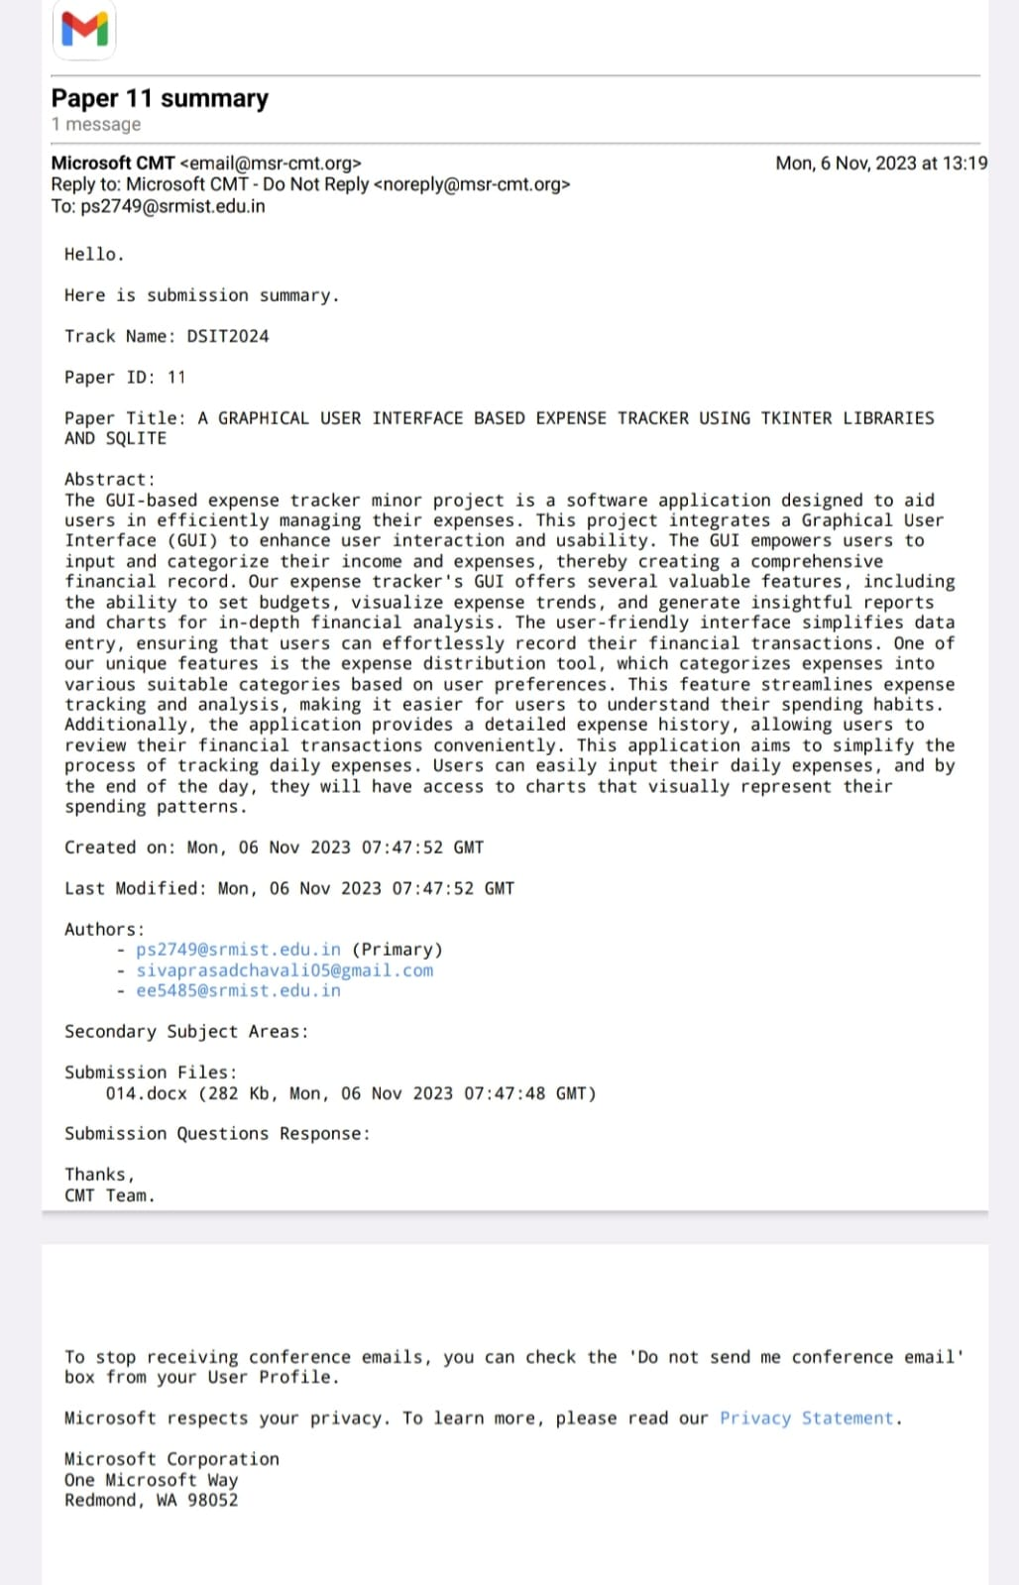
OUTCOME

